Slide 1
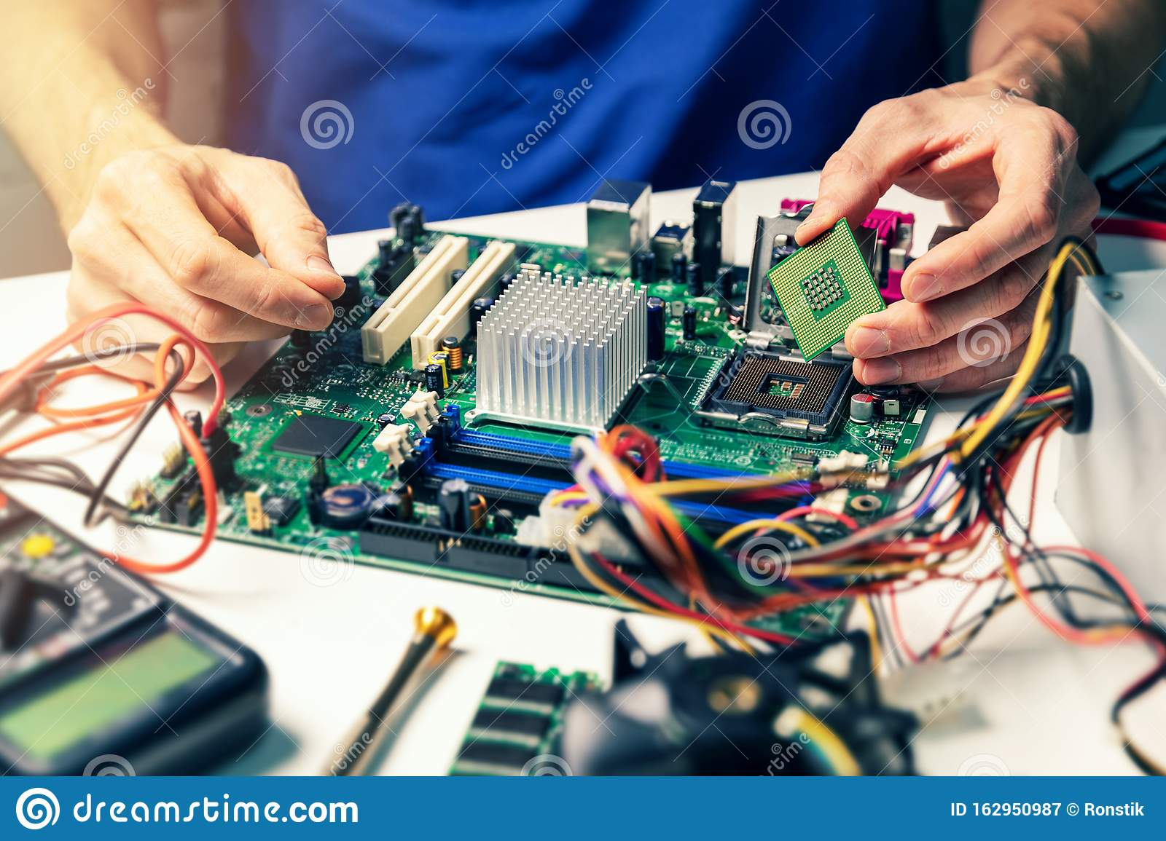

COMPUTER HARDWARE

Slide 2
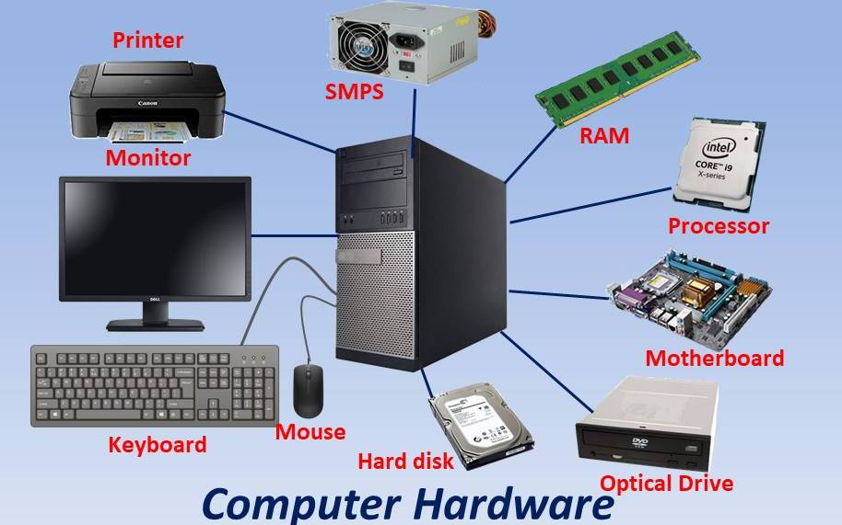
Computer hardware components
Motherboard
CPU
Keyboard
Mouse
RAM
Monitor
SMPS
printer
Hard disk drive
DVD drives

Slide 3
HARDWARE
How it works:
What is hardware
Computer hardware is the collection of all the parts which you can physically touch.
It includes the computer case such as the harddisk,motherboard,videocard and many others which you can physically touch.

Slide 4
MOTHERBOARD
the circuit board that connects all of your hardware to your processor
CPU
principle part of any digital computer system,generally composed of the main memory,control unit,ALU
KEYBOARD
A keyboard is putting information including letters,words and numbers into your computer
MOUSE
The is small,movable device tat lets you control a range of things on a computer
RAM
Ram stands for random access memory, ram is essentially short term memory where data is stored as the processor needs it.

Slide 5
Setting up Morph
MONITOR
A monitor is an electronical visual computer display that includes a screen.it is electronic output
PRINTER
Printer is also called computer printer,electronic device that accepts text files or images from a computer and transfers them to a medium such as paper or film
SMPS
SMPS is an electronic circuit that converts power using switching devices that are turned on and off at high frequencies
HARDDISK
A hard disk is a non- volatile data storage device. It refers to storage devices that maintain stored data when turned off.

Slide 6


Slide 7


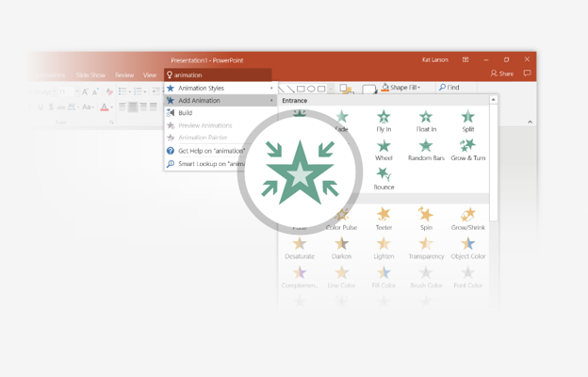
You’re an expert with Tell Me
The Tell Me box finds the right command when you need it, so you can save time and focus on your work. Try it:
SELECT ME
1
Select the Robot picture on the right.
2
Type animation in the Tell Me box, and then choose Add Animation.
3
Choose an animation effect, like Zoom, and watch what happens.

Slide 8
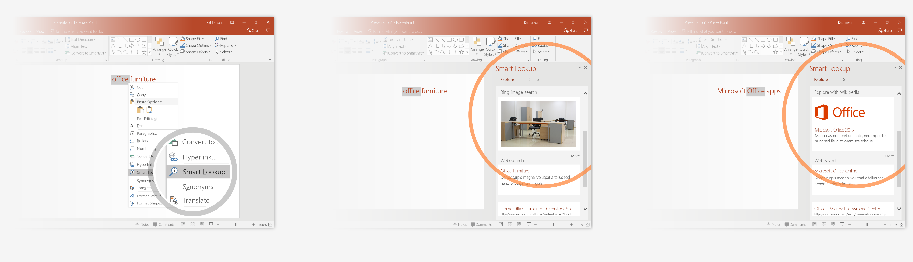
Explore without leaving your slides
Smart Lookup brings research directly in to PowerPoint. Try it:
1
Right-click in the word office in the following phrase: office furniture
2
Choose Smart Lookup, and notice that results are contextual for that phrase, not Microsoft Office apps.
3
Just for fun, try Smart Lookup again by right-clicking in the word Office in Step 2.

Slide 9

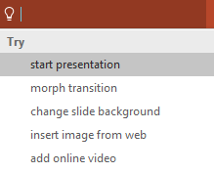

More questions about PowerPoint?
Select the Tell Me button and type what you want to know.
Visit the PowerPoint team blog
Go to free PowerPoint training
SELECT THE ARROW WHEN IN SLIDE SHOW MODE

